Slide 1
Business Intelligence in Practice Group Assignment Templae
Group number
Group members

Slide 2
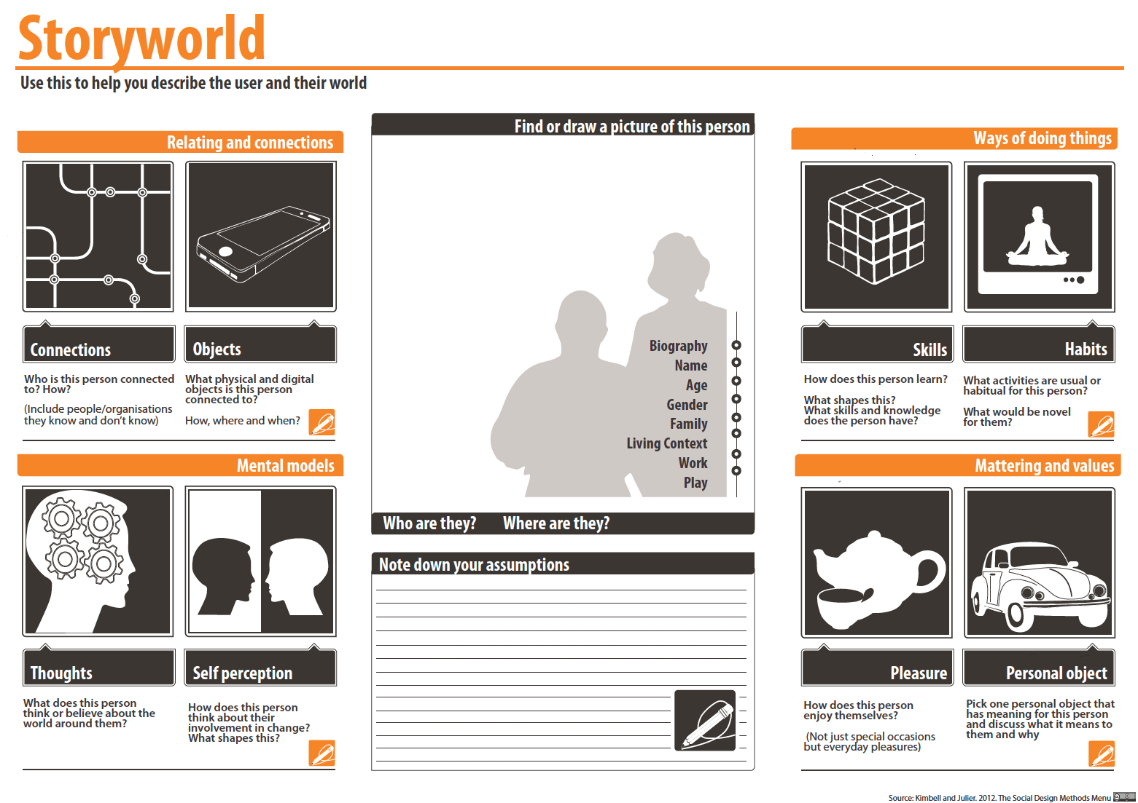
Problem definition Problem definition slides 1 For example, storyworld

Slide 3
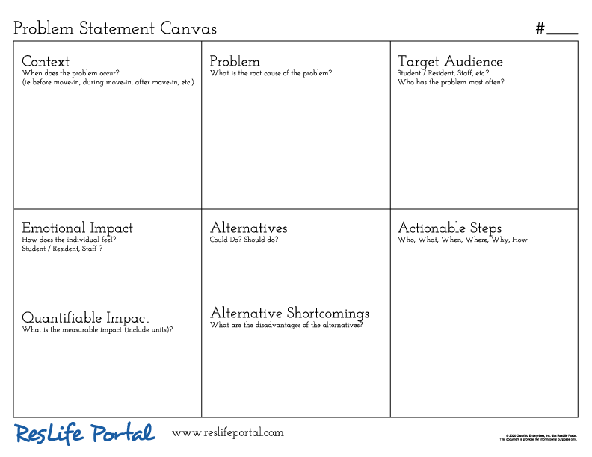
Problem definition Problem definition slides 2 For example, problem canvas

Slide 4
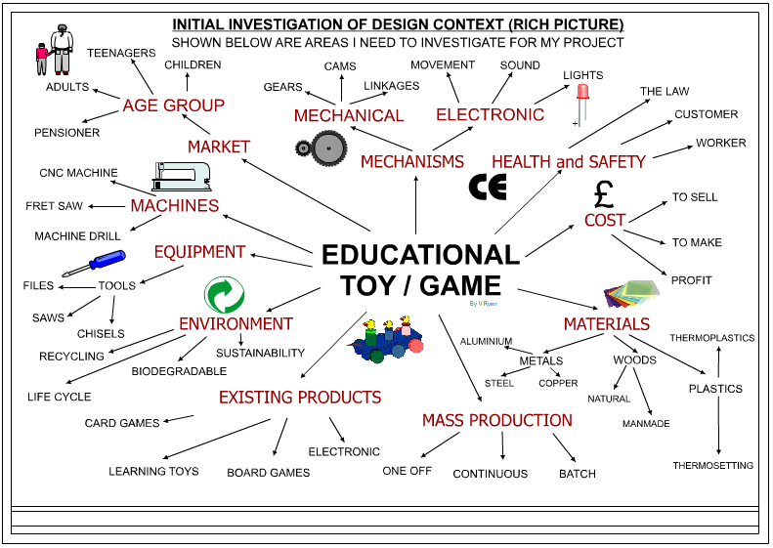
Problem definition Problem definition slides 3 For example, rich picture

Slide 5
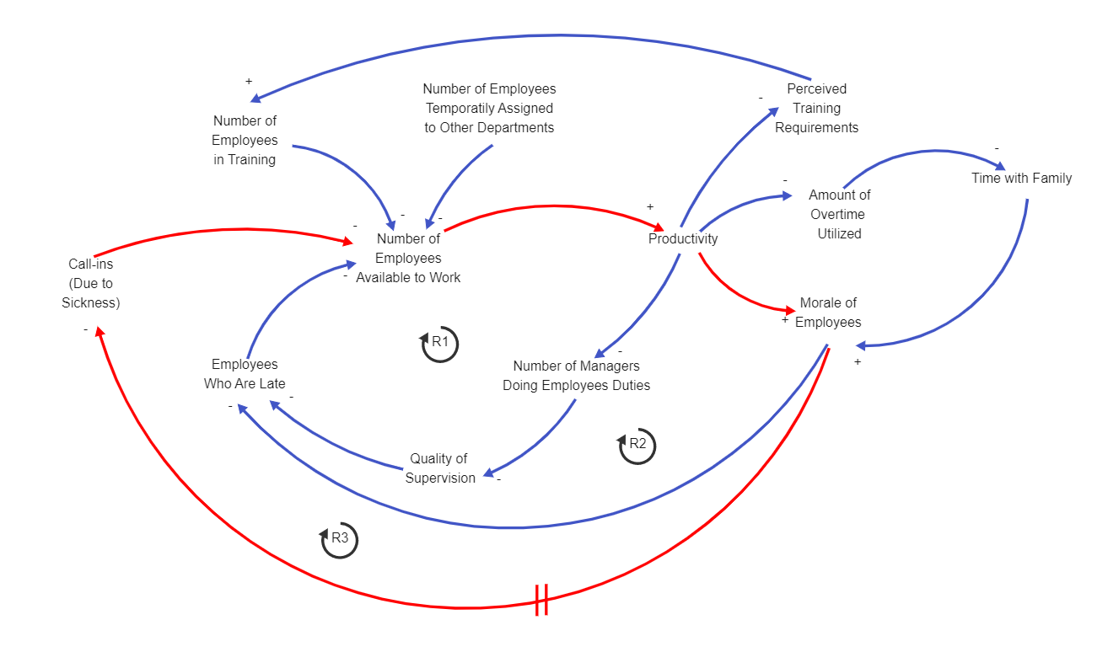
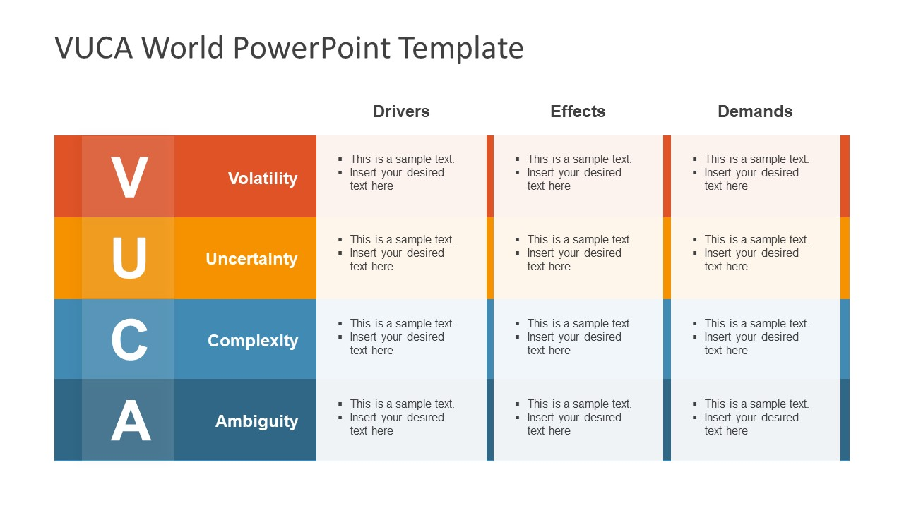
Problem definition Problem definition slides 4 For example, system thinking approach, VUCA Why this problem important etc.

Slide 6
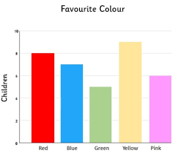

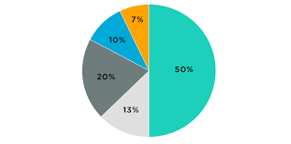
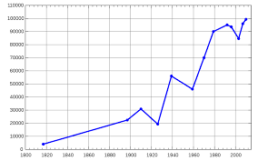
Problem definition Data support For example, questionnaire, Data charts

Slide 7
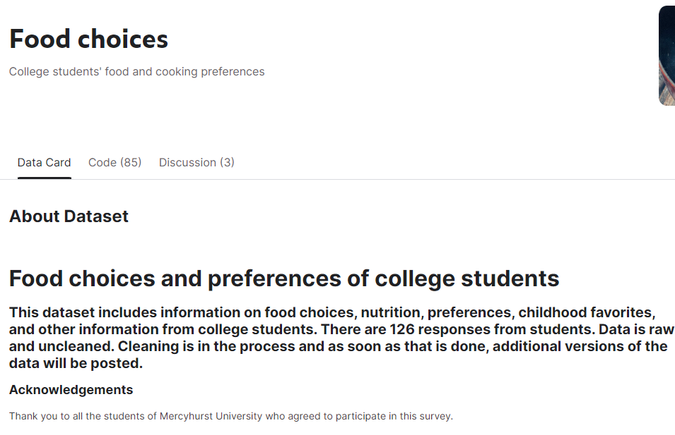
Related to Dataset selected Further analysis + Chart

Slide 8

Related to Dataset selected Further analysis + Chart

Slide 9

Related to Dataset selected Further analysis + Chart 3

Slide 10
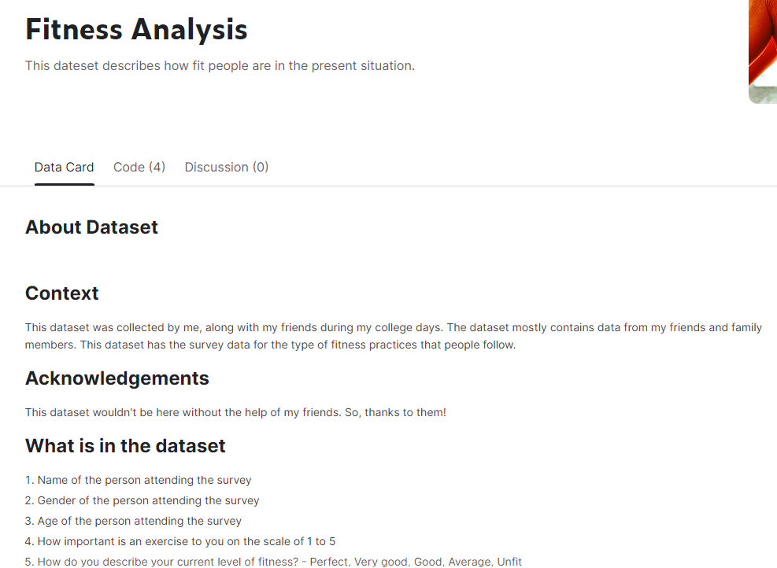
Related to Dataset selected Further analysis + Chart 4

Slide 11
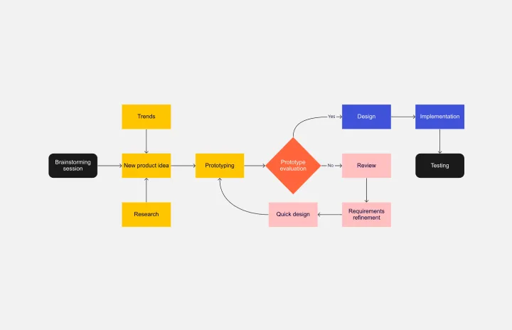
Solution How your solution works? Diagram, or flowchart to help demonstration

Slide 12
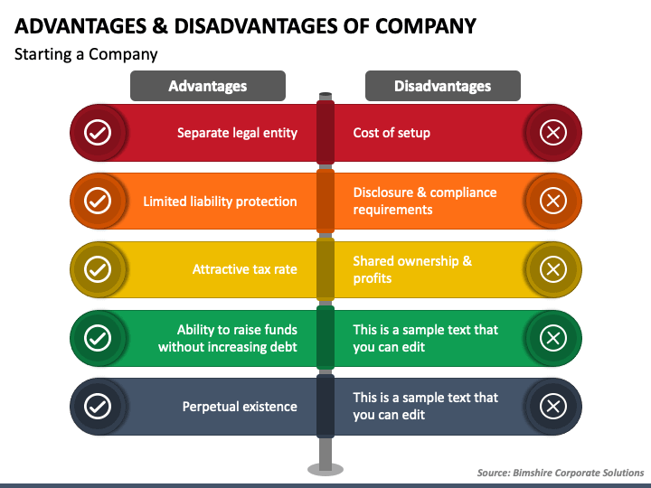
Solution Justification Analyse advantages and disadvantages

Slide 13




Solution Data support Could be open dataset, or your own survey data

Slide 14
Reference List
Each week readings
Harvard style
Cite paper, report, table, charts (anything not original)

